Slide 1
Sudoku solver
Thành viên: Phạm Lê Việt Anh
Hồ Đức Đạt
Nguyễn Tiến Đạt
Nguyễn Đức Hùng

Slide 2
Outline
Apply gaussian blur and adaptive thresholding
Find the contour of the biggest object in the image and assume it's a sudoku puzzle.
Extract object, perform a perspective transformation on it and divide it into 9x9 squares.
Look for contours inside every single square
Predict what's inside the squares that do have something by using ANN
Turned the sudoku into a simple 2D array and apply a sudoku solver algorithm
Write the new numbers into the squares that are considered empty.
Apply the opposite perspective transformation and paste our finished sudoku into the original image.

Slide 3
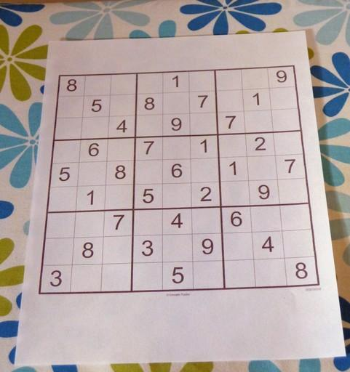
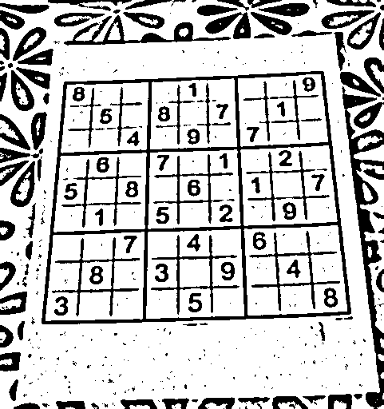
Apply gaussian blur and adaptive thresholding
Notes:
Từ dòng 14 đến dòng 18 file image_processing.py:
Gồm các bước: chuyển sang gray, dùng biến dổi hình thái open và dùng adaptive threshold

Slide 4
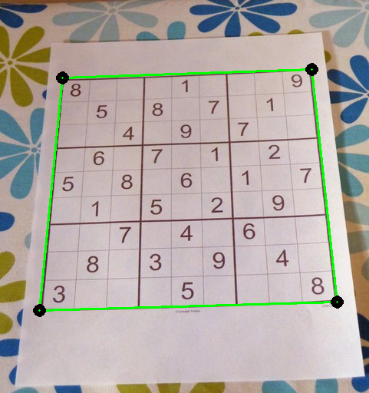
2. Find the contour of the biggest object in the image
Number of corners: 4
Area: 10k pixel
Notes:
Dong thu 74: if cv2.contourArea(cnt) > 10000:

Slide 5
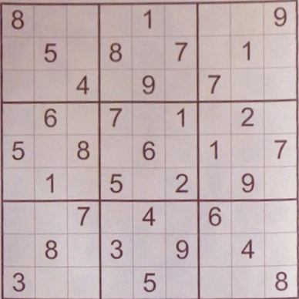
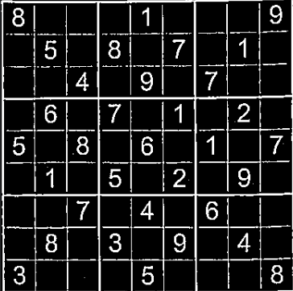
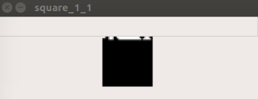
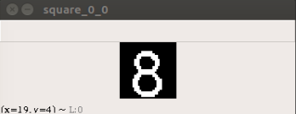
3. Extract object and divide it into 9x9 squares.

Slide 6
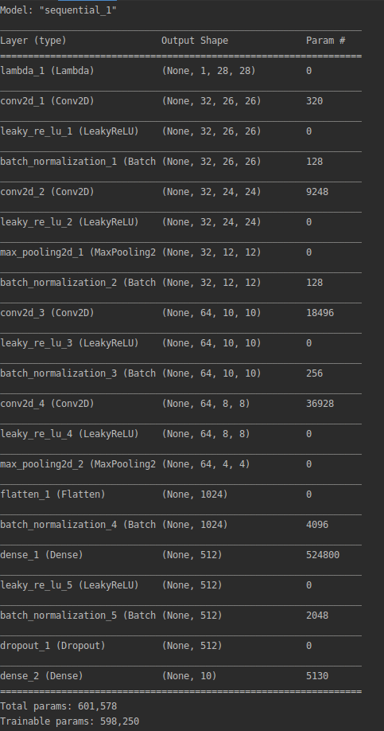
5. Predict digit
EMNIST Digits dataset:
https://www.nist.gov/itl/products-and-services/emnist-dataset

Slide 7
6. Turned the sudoku into a simple 2D array and apply a sudoku solver algorithm
apply a sudoku solver algorithm (http://norvig.com/sudoku.html).
800010009050807010004090700060701020508060107010502090007040600080309040300050008
8 7 2 |4 1 3 |5 6 9
9 5 6 |8 2 7 |3 1 4
1 3 4 |6 9 5 |7 8 2
------+------+------
4 6 9 |7 3 1 |8 2 5
5 2 8 |9 6 4 |1 3 7
7 1 3 |5 8 2 |4 9 6
------+------+------
2 9 7 |1 4 8 |6 5 3
6 8 5 |3 7 9 |2 4 1
3 4 1 |2 5 6 |9 7 8

Slide 8
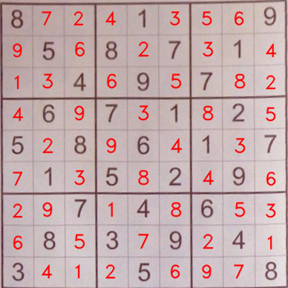
7. Write the new numbers into the squares that are considered empty

Slide 9
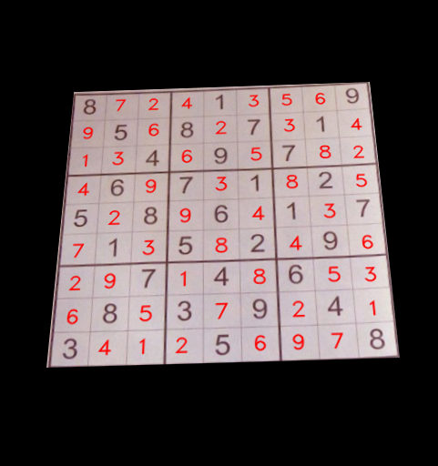
8. Paste our finished sudoku into the original image.
Using function perspective_transform(h, w, img_crop, transfor_matrix, original_shape)

Slide 10

8. Paste our finished sudoku into the original image.
Using function blend_non_transparent(img, img_sudoku_final):

